Slide 1
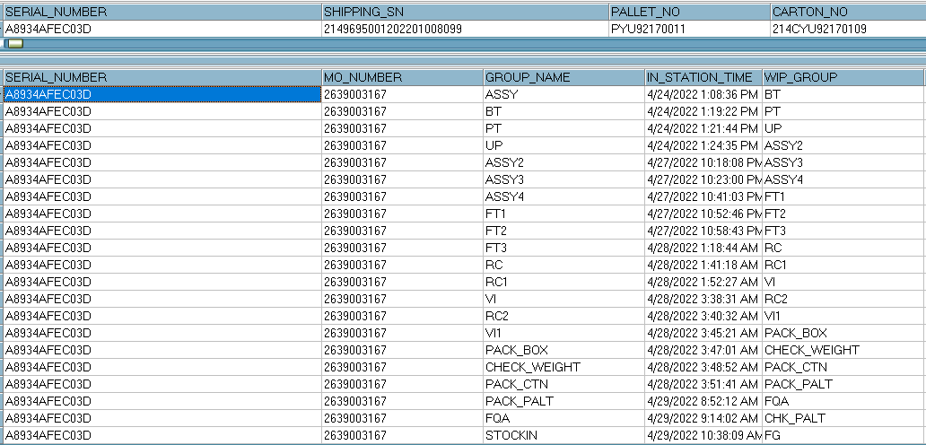
1. Ethernet unstable
Issue Description | FA | Root cause | Actions | Owner | Due Date | Status
Symptom: Ethernet unstable Type: Critical Defect unit Q’ty : 1/1088pcs Defect rate : 0.09% SKB SN: 2149695001202201008099 | 1. Fail symptom: As ALT feedback that they found out 2pcs Ethernet unstable (Ethernet link up is OK, but more than 50% packet loss occurred) 2. Check FATP data →Product test pass normally - At PT station: test program will test Ethernet CRC and throughput → This issue can cover at PT station 3. Suggestion - Check connection between RJ45 port and Ethernet cable - Measure impedance, voltage in U801 (Ethernet Precision Transceiver) location - Use oscilloscope to measure crystal frequency (Y801: 25MHz) generate CLK pulse for U801 | ➔ Waiting NG sample for Further analysis | → Require ALT send NG sample to Factory for analysis | PE: Mr. Thuc | 07/30

Slide 2
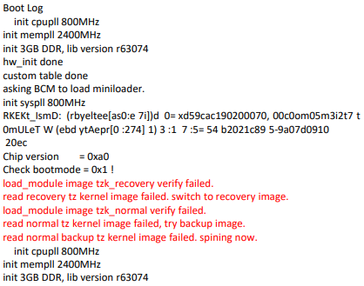
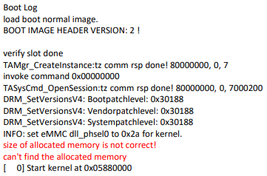
2. No boot
Issue Description | FA | Root cause | Actions | Owner | Due Date | Status
Symptom: Booting fail Type: Critical Defect unit Q’ty : 2/1088pcs Defect rate : 0.18% SKB SN: 2149695001202201009341 2149695001202201011465 | 1. Fail symptom: As ALT feedback that they found out 2pcs Booting fail ( Console log Check : abnormal log message, Image load fail2) 2. Check FATP data → Product test pass normally 3. Suggestion - Update customer SW - Use oscilloscope to measure crystal frequency (Y2: 25MHz) generate CLK pulse for Soc_U1 - Measure voltage: U68(1.05V), U69(1.05V), U64(2.5V), U1312(1.2V), U1310(3.3V), U1311(1.8V), U1308(5V) | ➔ Waiting NG sample for Further analysis | → Require ALT send NG sample to Factory for analysis | PE: Mr. Thuc | 07/30

Slide 3
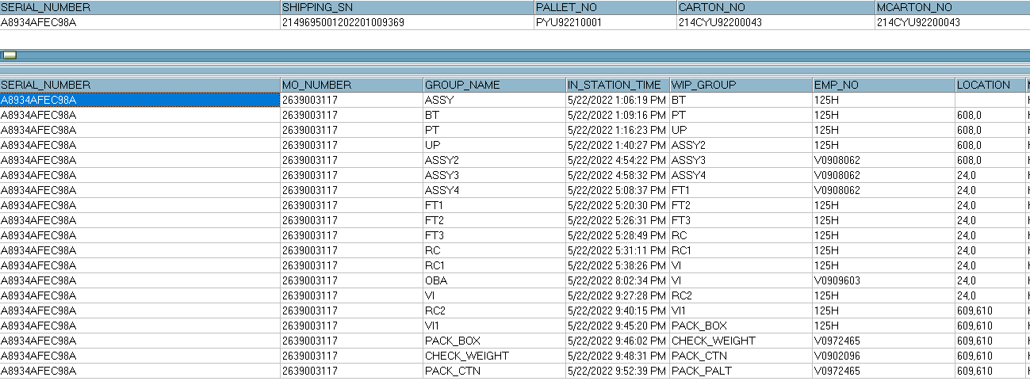
3. No Ethernet
Issue Description | FA | Root cause | Actions | Owner | Due Date | Status
Symptom: Ethernet does not work Type: Critical Defect unit Q’ty : 1/1088pcs Defect rate : 0.09% SKB SN: 2149695001202201009369 | 1. Fail symptom: As ALT feedback that they found out 1pcs Ethernet does not work (Can’t received IP address. Data led on the Ethernet connector is not turn on) 2. Check FATP data → Product test pass normally → At PT station : Test program will check Ethernet Led (Led Green and Yellow) and test Ethernet CRC and throughput ->This issue can cover on FATP 3. Suggestion - Check connection between U801 and Ethernet Led - Measure impedance, voltage in U801 (Ethernet Precision Transceiver) location - Use oscilloscope to measure crystal frequency (Y801: 25MHz) generate CLK pulse for U801 | ➔ Waiting NG sample for Further analysis | → Require ALT send NG sample to Factory for analysis | PE: Mr. Thuc | 07/30

